Slide 1


Legal Case
Hearing Prioritization
Abhishek Paudel
Saurav Dhungana
Mahesh Shakya
Cindy Rose Reyes
Sanjaya Poudel
Avishekh Shrestha
Sushant Gautam
Smriti Banjade
Ashutosh Upadhaya
Kailash Raj Bijayananda
Mentor : Prof. Suresh Manandhar
Notes:
Cover

Slide 2

Introduction
Legal Case Hearing Prioritization
Notes:
Start from this slide

Slide 3


JUSTICE
DELAYED
IS
JUSTICE
DENIED
Notes:
Delayed Justice have a destructive impact on country’s development, affecting economic growth and often resulting in long standing grievances that can last for generations.

Slide 4



Introduction
Notes:
The number of registered cases are increasing daily however, the number of judiciary workers are still the same. There is a lot of manual task that goes into processing the registered Documents.This is one of the reasons why the processing of documents is slow. It’s a high time we address this issue and come up with a feasible enough solution that can help in supplementing this manual work.

Slide 5



Annual Report
by the Supreme Court of Nepal/Fiscal Year 2016-17
254,529
88,850
61.8%
Total Cases
Backlog Cases
Disposal Rate
Total numbers of cases in courts handled by the court.
Cases pending from previous years that remain open at the start of a new fiscal year
Cases added to the docket during the year, resulting in no changes to the court's backlog.

Slide 6
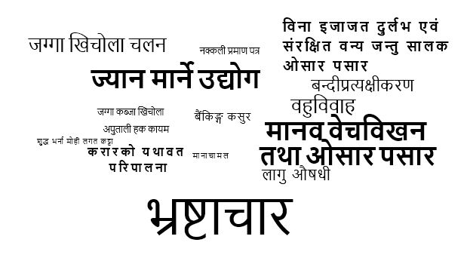
254,529
Total Cases
Annual Report by the Supreme Court of Nepal
In the Fiscal Year 2016-17

Slide 7

Project Description
01
Decision support system
for prioritizing case hearing in the Supreme Court
02
AI Enabled
Automate the process using NLP & ML to prioritize the cases
03
Use of Metadata
03
like type of case, date filed, previous hearings etc.
04
Priority Prediction
based on these features into buckets like urgent, high, medium, low which is annotated by clerks/lawyers/legal people.
Notes:
We propose a Decision support system for prioritizing case hearing in the Supreme Court.
This is enabled by an AI based solution that will automate this manual process by doing NLP on these documents and helping them prioritize the cases faster to reduce the backlog.
Also use metadata available like type of case, date filed, previous hearings etc.
It will predict the priority based on these features into buckets like urgent, high, medium, low which is annotated by lawyers/legal people.
We propose a Decision support system for prioritizing case hearing in the Supreme Court.
This is enabled by an AI based solution that will automate this manual process by doing NLP on these documents and helping them prioritize the cases faster to reduce the backlog.
Also use metadata available like type of case, date filed, previous hearings etc.
It will predict the priority based on these features into buckets like urgent, high, medium, low which is annotated by lawyers/legal people.

Slide 8
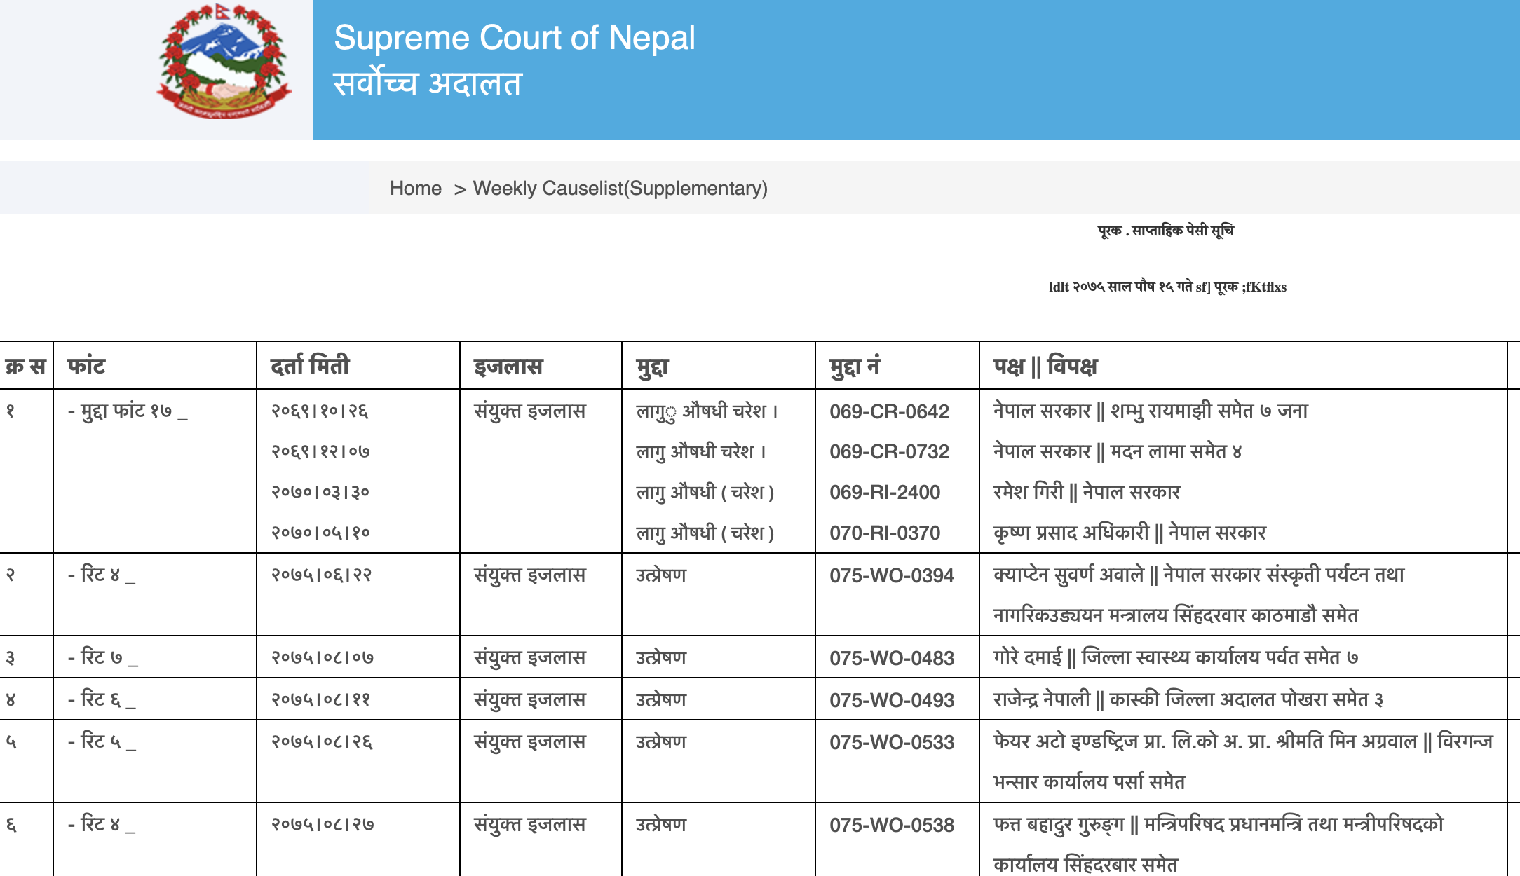
Notes:
The data we require is publicly available in the textual form

Slide 9


Key Benefits
Saves human hours by automating the manual task of reading through complex legal documents
Saves Time
Decrease Delays
Assist scheduling of case hearings to decrease court delays
Better screening of cases can help address backlog
Notes:
Clerks can use the time saved to work on other aspects of judicial workflow
Saves human hours by automating the manual task of reading and prioritizing complex legal documents
Assist scheduling of case hearings to decrease court delays, better screening of cases can help address backlog

Slide 10

High level Methodology
Compare Two Methods
Previous Case Files
Traditional Machine Learning VS
Deep Learning
Datasets to train our models
Notes:
Text analysis and Topic Modeling: Unsupervised Learning -- Clustering,Latent Variables and Structures (how variables relate to one another, hidden thematic structure)
Topic models are a suite of algorithms that uncover the hidden thematic structure in document collections. These algorithms help us develop new ways to search, browse and summarize large archives of texts.
given official documents, particular words would appear in similar documents more frequently.
The "topics" produced by topic modeling techniques are clusters of similar words
Input : Dataset collection of official documents.
Output : Cluster of Words, frequency of words and distribution of topics.

Slide 11
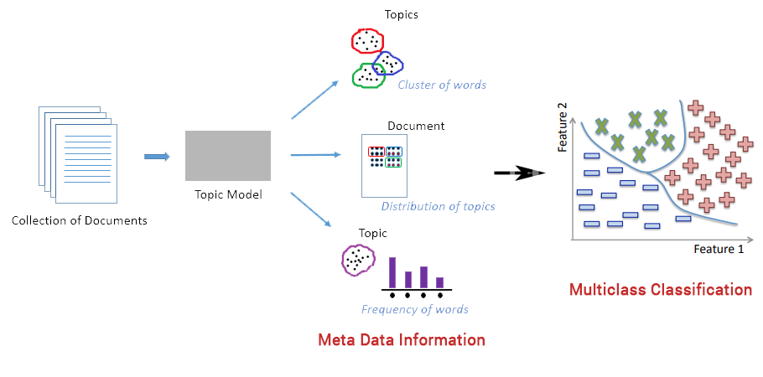
Topic Modeling & Supervised Learning
Notes:
We use the output of unsupervised learning through Topic Modeling as input to supervised learning multiclass classification task.

Slide 12

Alternate Algorithm
BI-LSTM
Additional Metadata
for classifying documents into labels
Use Named Entity Recognition to distinguish
Labels: Binary Priority
Apply Word Embedding
Urgency Level
Low/Normal/High/Critical
to represent words in Latent space and feed the resulting Tensor into bi-LSTM
Similar Work
Document Classification on Brazilian Supreme Court using CNN
Braz, Silva et al NeurIPS 2018 Workshop on ML4D

Slide 13
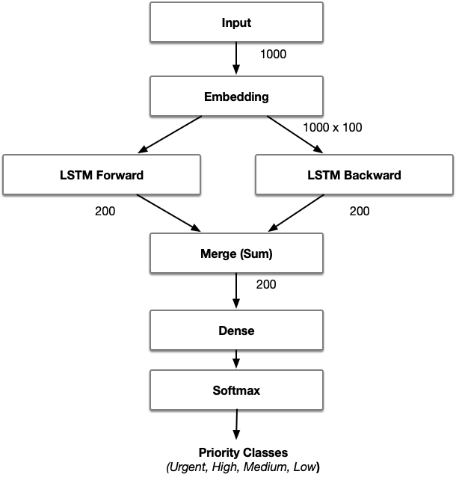
Bi-LSTM with word embedding
Notes:
Historical sequential data being available Bi-LSTM Model is the preferred choice.

Slide 14
Additional Information
Preprocessing - tokenize, remove stopwords, take first 1000 tokens from each document as representative of the whole document,out-of-vocabulary word?
The results from Bi-LSTM is not sensitive to the form of word embedding (word2vec, GloVe)

Slide 15
References
Martin, John A., and Elizabeth A. Prescott. Appellate court delay: Structural responses to the problems of volume and delay. Williamsburg, VA: National Center for State Courts, 1981.
Huang, Zhiheng, Wei Xu, and Kai Yu. "Bidirectional LSTM-CRF models for sequence tagging." arXiv preprint arXiv:1508.01991 (2015).
Rao, Adithya, and Nemanja Spasojevic. "Actionable and political text classification using word embeddings and lstm." arXiv preprint arXiv:1607.02501 (2016).
Braz, Fabricio Ataides, et al. "Document classification using a Bi-LSTM to unclog Brazil's supreme court." arXiv preprint arXiv:1811.11569 (2018).
da Silva, N. Correia, et al. "Document type classification for brazil’s supreme court using a convolutional neural network." 10th International Conference on Forensic Computer Science and Cyber Law (ICoFCS), Sao Paulo, Brazil. 2018.
Accessed on Dec 30, 2018. http://www.eastasiaforum.org/2018/12/14/beating-the-backlog-in-lao-courts

Slide 16



Slide 17

Notes:
It was an awesome journey with the winter school. .. thanks to organizers and some

